Slide 1
Cookbook for Practice 3.2
实践3.2攻略
Cong Li 李聪

Slide 2
Vector 向量
Duplicate ‘simple.cpp’ as ‘vector.cpp’
将’simple.cpp’复制为’vector.cpp’
In this program, we employ the similar operation pattern on the 1-D arrays, mathematically vectors
在这个程序中，我们也采用类似的模式操作1维数组，数学上就是所谓的向量

Slide 3
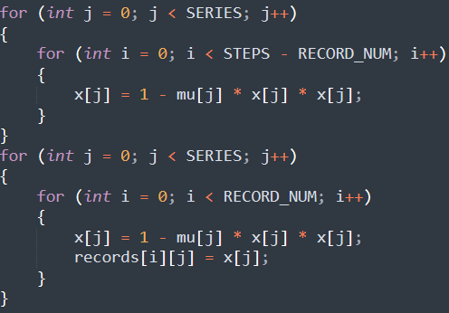
Split the Loop 拆分循环
Split the outer loop into 2 loops
将外重循环拆分为两个

Slide 4


Re-order the Loops
重排循环 (1)
Re-order the inner loop with the outer loop
将内重循环与外重循环重排，交换位置
to
为

Slide 5


Re-order the Loops
重排循环 (2)
For the 2nd part, perform the same re-ordering
对于第二部分，进行同样的重排
to
为
Compile & run it 编译并运行之
mingw32-make SRC=vector.cpp NATIVE=1
run-vector.exe

Slide 6
The End

